Slide 1
Resources of
Smolevichi region

Slide 2
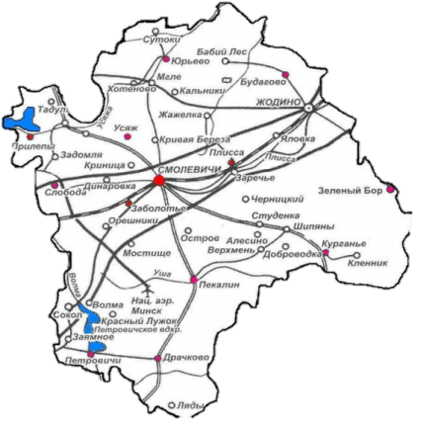
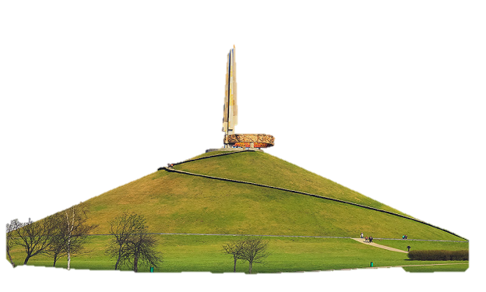
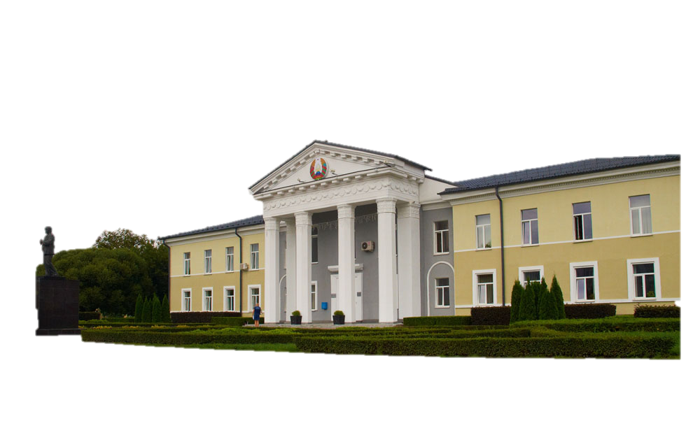
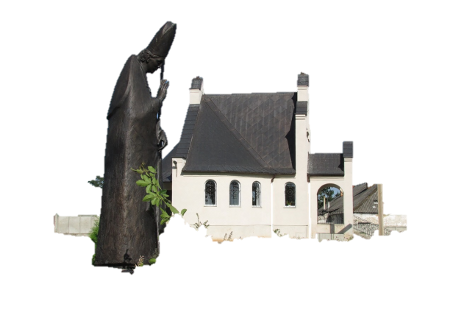
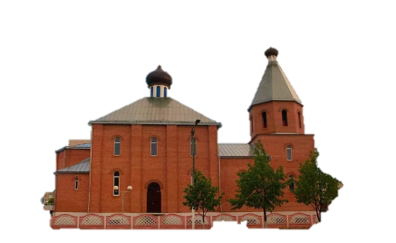
MAIN NATURAL RESOURCES
SAND AND GRAVEL
BUILDING SAND
PEAT
SAPROPEL
WOOD

Slide 3
LAND FUND OF SMOLEVICHI REGION
AGRICULTURAL LAND – 69,65 thousand hectares
ARABLE LAND– 57,25 thousand hectares
MEADOW LAND – 11,8 thousand hectares
FOREST LAND– 46,97 thousand hectares
LAND UNDER SWAMPS – 1,05 thousand hectares
UNUSED LAND– 6,95 thousand hectares

Slide 4
PERSONNEL POTENTIAL OF SMOLEVICHI REGION
Population as of January 1, 2023 – 54627 people, including:
urban population– 22959 people
rural population – 31668 people
Labor force– 27885 pepople, including:
male labor force – 14414 people;
female labor force – 13471 people;
with higher education– 6927 people;
with secondary vocational educational – 11839 people.

